Slide 1

Home Loan Approval Predictor
DSC 680 Applied Data Science
Chitramoy Mukherjee, T301 T302 2253 Winter 2025

Slide 2
Introduction
The Home Loan Approval Predictor project aims to streamline the loan approval process using machine learning techniques. This project was initiated to address the lengthy and often stressful loan approval times faced by applicants. By leveraging AI and ML, the goal is to enhance decision speed and accuracy, ultimately improving customer satisfaction.
Problem Statement
In the financial sector, accurately predicting the approval of home loan applications is a critical task for lending institutions. The goal of this project is to develop an intelligent system capable of predicting home loan approval based on various applicant attributes. By leveraging machine learning techniques, financial institutions can improve their decision-making processes, minimize risk, and enhance customer satisfaction.
The task is to build a predictive model that accurately determines whether a loan application will be approved or rejected.

Slide 3
Background and Data Sources
The project typically involves analyzing a dataset of loan applications, which includes various financial and demographic variables such as credit score, annual income, employment status, debt-to-income ratio, and previous payment history. These variables are used to build predictive models that can assess the likelihood of loan approval.
The concept of using AI/ML for loan approval gained traction as financial institutions sought to improve their risk assessment and decision-making processes. Early projects focused on exploratory data analysis (EDA) to identify key predictors of loan approval. Over time, more sophisticated models were developed, incorporating various machine learning algorithms to enhance predictive accuracy.
Datasets :
test.csv from www.kaggle.com
train.csv from www.kaggle.com

Slide 4
Methods/Steps
Data Preparation
Data Preprocessing
Exploratory Data Analysis (EDA)
Model Training
Model Training and Evaluation
Model Monitoring and Maintenance
Model outcome comparison

Slide 5
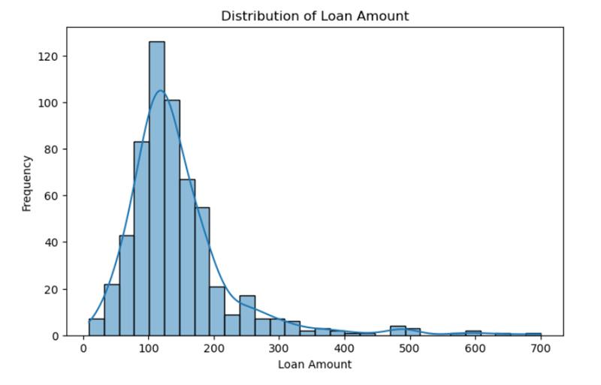
Distribution of Loan Amount with Histogram plot :
Most applicants request relatively small loan amounts.
The right-skewed nature suggests that fewer people take out very large loans.
This distribution can help adjust loan approval strategies or risk assessment models.

Slide 6
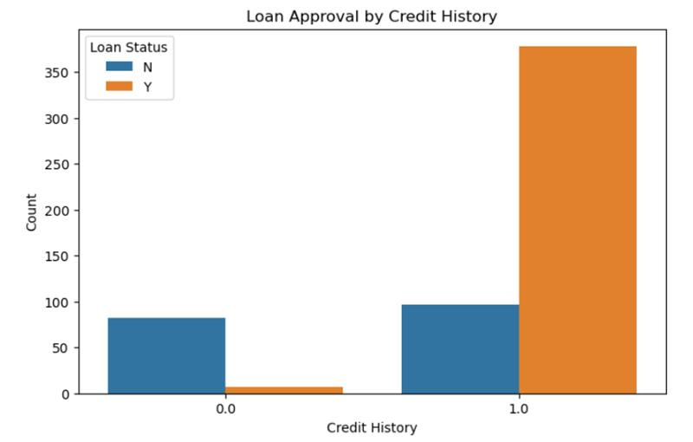
Outcome of Loan Approval by Credit History Plot with Bar diagram:
Credit history is a strong determinant of loan approval.
Loan applicants with no or poor credit history face challenges in getting approval.
This insight can be used to improve loan eligibility criteria and risk assessment.

Slide 7
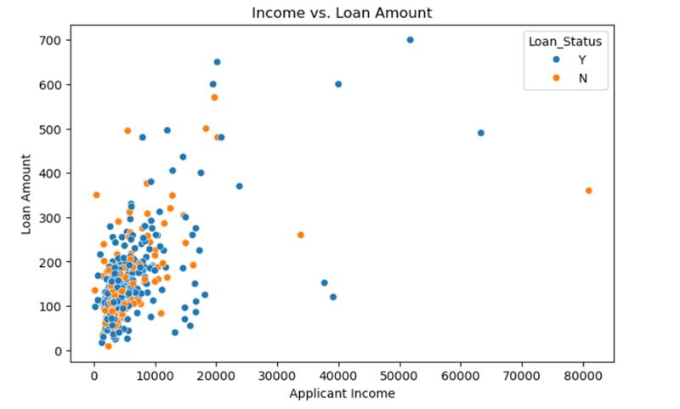
Outcome of Income vs. Loan Amount Plot, Scatter plot:
There may not be a strong linear correlation between income and loan amount.
Some low-income applicants still receive high loan amounts, indicating other factors (like credit history) play a crucial role.
The presence of outliers suggests a need for further investigation, possibly by normalizing income values.

Slide 8
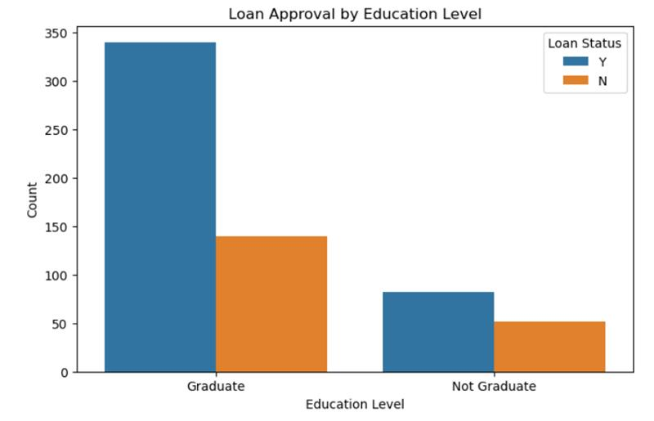
Education Level Plot with Bar diagram:
Education level influences loan approval but is likely not the sole deciding factor.
Additional factors such as income, credit history, and employment type may also play a role.
The bank might consider alternative risk assessment methods for non-graduates to improve approval fairness.

Slide 9
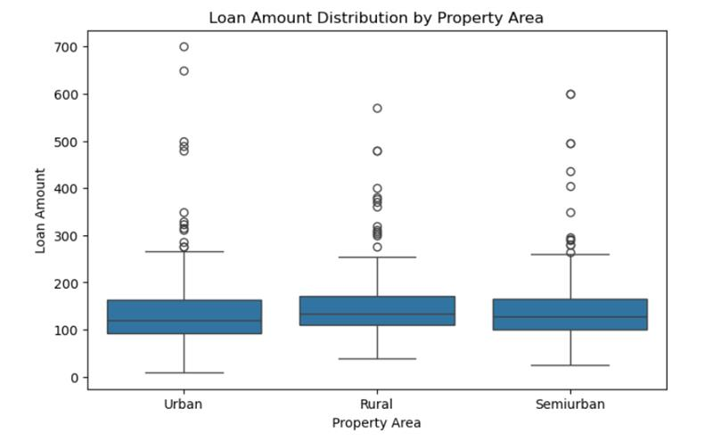
Outcome of Loan Amount Distribution by Property Area Plot
Certain property areas (e.g., urban areas) might have higher loan amounts on average due to higher living costs.
Rural areas might have lower median loan amounts, possibly due to lower property values or applicant income levels.
The variability in loan amounts suggests that property area influences the loan distribution.

Slide 10
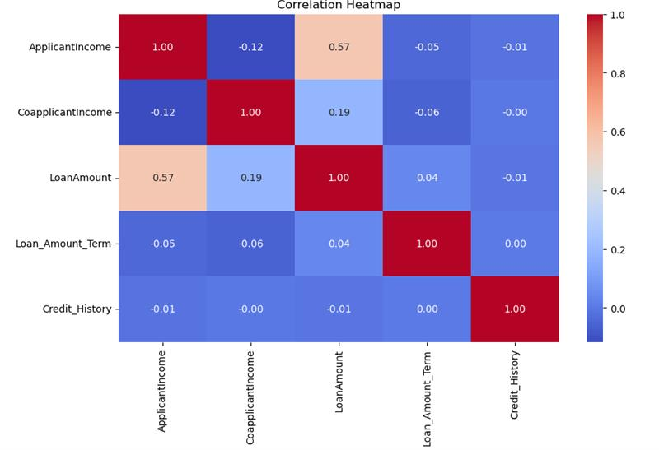
Outcome of Correlation Heatmap:
Features with higher correlation to Loan_Status can be prioritized in the ML model for prediction.
Some features (like LoanAmount and Income) may need normalization due to skewness.
If strong multicollinearity exists (e.g., high correlation between ApplicantIncome and CoapplicantIncome), feature engineering techniques like PCA or removal of redundant features might be useful.

Slide 11
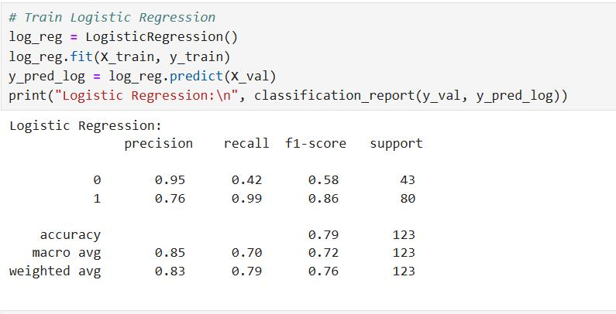
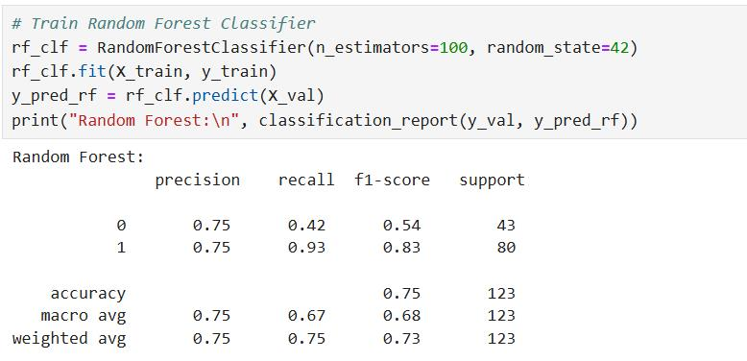
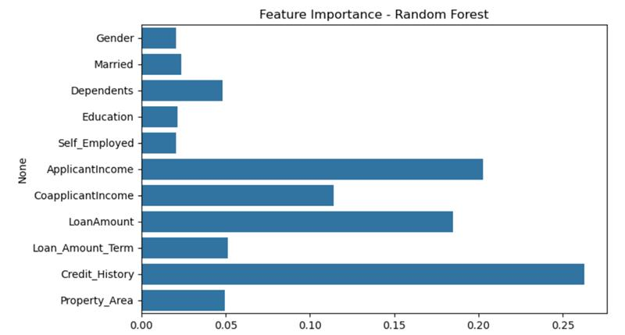
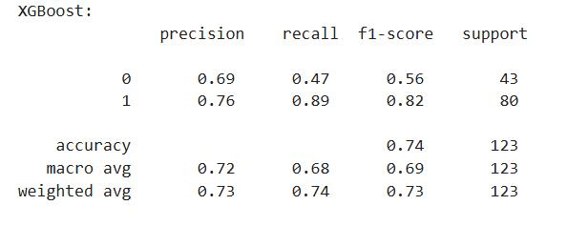
ML Algorithms Outcome:

Slide 12
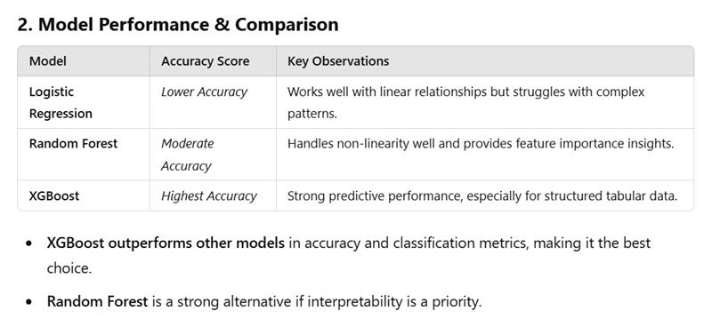
Model Performance:

Slide 13
Thanks!!!

